Slide 1

HOLY TRINITY UNIVEVRSTY

Slide 2
GROUP 3 Daoism(taoism
HOLY TRINITY UNIVEVRSTY
DEPARTMENT OF DOGEMA
HISTORY OF RELIGION
Taoism(Daoism
Group assignment
Student name id
1.Biruk Dinku w-070/15
2.Biruk Lemma w-071/15
3.Desalegn Getu w-093/15
4.Michael Zewdu w-191/15
5.Mileyon Debebe w-193/15
6.Misrake Begashaw w-195/15
submited to mr. Gitache
submited date 12/22/2024

Slide 3
INRODACTION
The origins of Daoist teachings are not known. Some scholars trace the first evidence to about 5,000 years ago, when shamans were thought to guide society. Shamans reputedly had the power to shape-shift between human and animal forms, take celestial journeys, and descend to an underworld. They could read omens, had revelations, and acted as healers, diviners, and interpreters of dreams. There were several mythical shamanic figures associated with ancient Chinese history, and it seems that some elements of shamanism were found in early Daoist ceremonies. At a certain point in ancient times, there seem to have been people who had direct experience of the superconscious state that we call God – in Chinese language referred to as the Dao (Tao). These superconscious beings developed a spiritual practice or method to quiet the mind and attain inner stillness, and eventually taught that sublime experience to their disciples. There is evidence of these practices in the fourth-century BCE text Nei-yeh (“Inward Training”), although the human experience of this divine presence probably goes back much farther than that. The many remote, austere mountain ranges of China would have provided countless caves and solitary spots where hermits could practice.

Slide 4
INRODACTION
The Daoist teachings, as they developed and were recorded, impart certain principles of spiritual life and how to live in the world – essentially the need to find harmony and balance within, vii often referred to as holding on to the center, the Dao. Literally Dao means “the Way”; the term refers to the superconscious, formless origin of the creation, the dynamic principle immanent in all the creation. It also refers to the inner path of the soul rediscovering its spiritual identity and origin, the inner Way. The path of Dao teaches the principles of living in harmony with nature and not trying to dominate it: “leading from behind” rather than pushing oneself forward, and wu-wei (selfless action, or acting without selfish motive) – going with the flow of life. The Dao implies an understanding that true inner balance and harmony occur at the center point between the opposites of yang (outward, masculine) and yin (inward, feminine) – cogently explained through the text of the Yijing (I Ching, the “Book of Changes”), an ancient divination manual which dates from as early as the tenth century BCE. Scholars believe that this is the most ancient text that presents the teachings eventually associated with Daoism

Slide 5
INRODACTION
Daoism is the term used to designate a cluster of beliefs and practices that developed among Chinese recluses who had a strong affinity for nature. It is sometimes referred to as a form of nature mysticism. It derives its name from the word Dao, “the Way,” a term and concept that is not exclusive to Daoism but is used in all the major Chinese religio-philosophical traditions. Daoism is often divided into a philosophical wing, Daojia, and a religious wing, Daojiao. The two main contributors to classical Daoist philosophy are Laozi and Zhuangzi, both of whose lives are cloaked in legend. It is difficult to say with certainty if either of them really existed. Laozi is believed to have been born in the sixth century BCE, somewhat earlier than Confucius. However, scholars place the Daodejing, an enormously influential text attributed to him, anywhere between the sixth and fourth centuries BCE.

Slide 6
Daoism is the term used to designate a cluster of beliefs and practices that developed among Chinese recluses who had a strong affinity for nature. It is sometimes referred to as a form of nature mysticism. It derives its name from the word Dao, “the Way,” a term and concept that is not exclusive to Daoism but is used in all the major Chinese religio-philosophical traditions. Daoism is often divided into a philosophical wing, Daojia, and a religious wing, Daojiao. The two main contributors to classical Daoist philosophy are Laozi and Zhuangzi, both of whose lives are cloaked in legend. It is difficult to say with certainty if either of them really existed. Laozi is believed to have been born in the sixth century BCE, somewhat earlier than Confucius. However, scholars place the Daodejing, an enormously influential text attributed to him, anywhere between the sixth and fourth centuries BCE.

Slide 7
INRODACTION
The Daodejing, also known as the Laozi, consists of two parts: the first dealing with the Dao (Way) and the second treating the concept of De (Power). Archaeological discoveries made in the mid-1970s uncovered manuscripts of the text dating to the second century BCE in which the second part precedes the first. Some scholars thus contend that the practical political dimensions of the philosophy found in the second part were more important to the redactors of those manuscripts (and the political leaders of that period) than the theoretical metaphysics of the section on the Dao.The Zhuangzi, attributed to the sage with the same name, may well have had multiple authorship. Zhuangzi is believed to have lived at the time of Mencius (ca. 300 BCE). Unlike the Daodejing, his text displays a disdain for politics and for the ruler or bureaucrat’s application of its philosophy. With considerable use of humor and anecdote, it espouses a contemplative lifestyle and a renunciation of social conventions in order to achieve a fusion with the mysterious principle of nature, the Dao.

Slide 8
INRODACTION
Daoist philosophy developed during the subsequent centuries. Between the third and sixth centuries CE, in the social upheaval that followed the collapse of the Han dynasty, a movement designated by scholars as Neo-Daoism emerged. It was characterized by nonconformity and a criticism of the social establishment. Akin to the counterculture movement of the 1960s in the West, various factions in the Neo-Daoist movement promoted a naturalistic hedonism, with freedom from the constraints in the way one was traditionally expected to speak to others, to dress, or to relate to elders and other authorities. Neo-Daoism embraced creativity in poetry and art and espoused an appreciation for the unique creations of nature. Its legacy still endures in many aspects of East Asian aesthetics

Slide 9
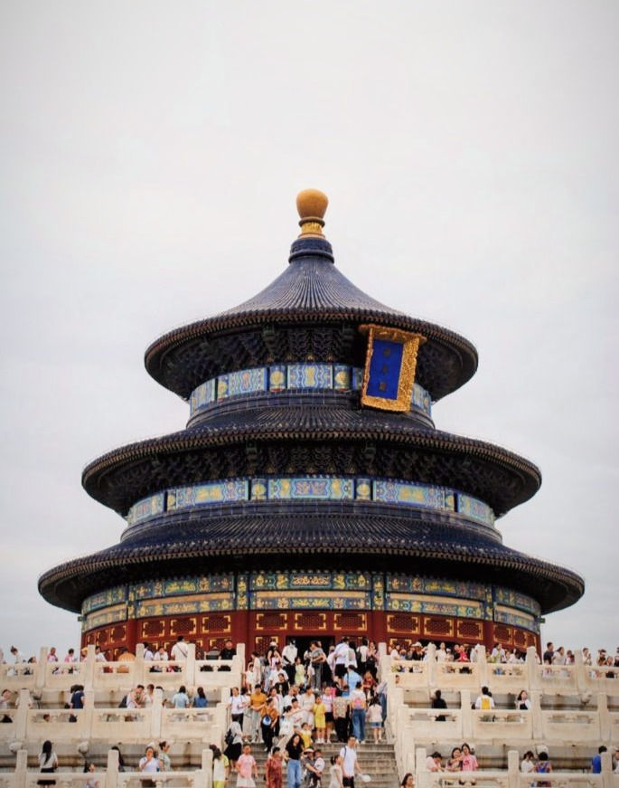
INRODACTION

Slide 10
1.COSMOS
I would cover the two key basic concepts of Daoism, ziran (self-existent, of its own nature) and wu-wei(non-doing), as taught by Laozi and Zhuangzi. The academic world’s understanding of these terms is different from the way those of us who practice Daoism understand them.
The Western cultures, including Chinese culture, are focused on human beings. They consider human beings as the center of the universe; Daoism is the opposite. The ziran and wu-wei are the core characteristics or intrinsic nature of Dao, and everything comes from that. Dao is the origin of everything (in the creation). We human beings and everything in the
creation have their own intrinsic, original nature, i.e., ziran. “The Great Dao exists in myriad things,” says the Daodéjing. This is the meaning of it. (The allpervading intrinsic nature of everything is the Dao.)The term ziran appears in Chapter Twenty-five of the Daodéjing, where the text gives us a sense of the order of the creation – each level is dependent upon the one higher – but the
Dao is the origin of all, self-existent and pervading all:
The human being emulates earth.
Earth emulates heaven.
Heaven emulates the Dao.
The Dao exists by virtue of itself, self-existent.
Master Meng explained the deeper level of meaning of the
term ziran

Slide 11
2.Destinty
They say that my life is in my own hands, not in Heaven’s (God’s) hand, and does not depend
on destiny.“Do you carry your destiny from your previous life?” I asked him.
“Yes,” he answered, “but what you do in this life can change it.”
“So you have some free will?” I asked. With great conviction, he answered:
Yes, because human beings have the ability to understand the mystery of the universe. If they can grasp the mystery of the universe, they can transcend their
destiny. Daoism has a high regard for human beings,
INTRODUCTION TO THE DAO
because they don’t have to passively accept destiny.
They have the ability to discover the natural law and
have it serve their own purpose. The Daoist classic
“Scripture of the Harmony of Seen and Unseen,” also
translated as “Classic of the Yin Convergence,” says,
“Observe the Dao of heaven; then you can have a
grasp of the way the divine works, through practice.”

Slide 12
3. DeityIn
Daoism is the term used to designate a cluster of beliefs and practices that developed among Chinese recluses who had a strong affinity for nature. It is sometimes referred to as a form of nature mysticism. It derives its name from the word Dao, “the Way,” a term and concept that is not exclusive to Daoism but is used in all the major Chinese religio-philosophical traditions. Daoism is often divided into a philosophical wing, Daojia, and a religious wing, Daojiao. The two main contributors to classical Daoist philosophy are Laozi and Zhuangzi, both of whose lives are cloaked in legend. It is difficult to say with certainty if either of them really existed. Laozi is believed to have been born in the sixth century BCE, somewhat earlier than Confucius. However, scholars place the Daodejing, an enormously influential text attributed to him, anywhere between the sixth and fourth centuries BCE.

Slide 13
Daoism there is a lot of discussion about “internal alchemy,” and I asked Dr Yin whether it signifies a form of meditation. In his view it is not a form of meditation. It is actually a refining of our coarse physical being into energy, and ultimately into spiritual light.Dao manifesting in an individual, as that person’s inherent intrinsic nature. I asked him if he would say that love is our essential dé – not love as an individual quality but as a universal power. There is difference between the Chinese and Western culture and religion. Love is a concept in Christianity; in Daoism, the basic principle is life or creation – it is to allow life in the creation, for example the producing of a plant. The core of the creation is probably the same as the power or force of love. The Daoist view of creation is to welcome the life of everything. The Chinese culture’s view of the Dao as mother has not so much to do with love but with the creative power. There are two levels of practice in Daoism – one is the actual practice with techniques.

Slide 14
3. DeityIn
The other level is awareness or enlightenment to Dao – that does not need language. Only experience is required to raise awareness. So it doesn’t matter if the practitioner is a Chinese or Westerner. The Chinese Daoists rarely personified God. They taught that the Dao is the divine principle that has always existed before creation, and which provides the path back to union with the great emptiness of non-being. They taught people to live in accord with the Dao and to allow their dé, or inner potency, to nurture their intrinsic inner nature. When sages emphasized the importance of living according to wu-wei, they were teaching their disciples to remove personal motives from their actions and be detached from the results; not investing themselves intellectually or emotionally but allowing nature to take its course. Daoist classics like Daodéjing and Zhuangzi use metaphors from nature to show how to live in the Dao according to the principle of wu-wei. The events of life will keep rolling along, but the sage withdraws, rejecting self-importance and the need to interfere in event

Slide 15
4. Man:
The ideal of living in harmony with Dao leads to the principle of wu-wei. Sometimes defined as “doing without doing,” “actionless action,” or “non-interference,” wu-wei describes action without personal motive. It means immersing oneself in the natural flow of life, letting oneself be carried by the current of Dao without imposing one’s own ego or will. It presupposes an acceptance that life has its own momentum, its own pattern, and that human beings need to submit to it and not impose themselves.As Professor Ellen Chen, translator and scholar of the Daodéjing, writes:

Slide 16
4.Man:
Daoism does not regard humans as the only active
agents. Nature untouched by civilization is a dynamic
realm while human action (wei) only interferes with and stifles the natural processes of things. Dao lets all beings operate on their own, accomplishing everything by doing nothing (wu-wei).The action that characterizes Dao is called transformation or self-transformation. Human action (wei), imposing an order on nature, is disruptive and destructive; transformation is the process by Humility allows him to live effortlessly and do “nothing to disturb the spontaneous flow of things.”

Slide 17
4.Man:
The Daodéjing gives this advice: , one increases day by day; To cultivate Dao, one reduces day by day. Reduce and reduce and keep on reducing, Till the state of non-interference (wu-wei) is reached.60 Human intervention in the affairs of the world is not necessary – not even for kings and rulers, much less so for the rest of us or any other of the myriad beings of creation. Dao everlasting does not act (wu-wei), and yet nothing is not done. If kings and barons can abide by it, The ten thousand things will transform by themselves. The sage or spiritual master embodies the ideal of wu-wei; he lives in the current of Dao. In keeping with this principle, he never promotes himself. He is modest and humble. He is not interested in creating a personality cult around himself, but rather acts as a guide for his disciples in cultivating the Dao, so they can experience it for themselves. Disciples must undertake their own spiritual cultivation, under their master’s guidance. This cultivation includes their way of life in the world as well as their inner meditation practice. The Huainanzi offers this description of the sage who cultivates the essential and lets go of the superficial

Slide 18
5 . Salivation
The Salvation through Refinement renewed Chinese traditional theories like yin-yang and the five phases and put them in ritual texts to instruct refinement for self-cultivation and saving other lives as well. As a text oriented toward universal salvation, the scripture claimed that people in many kinds of situation will be saved if they recite this scripture. They will either be reborn as honored men or become transcendents flying in the heaven of Jade Capitoline.
The Dao said:
Whenever anyone chants this scripture ten times, all the heavenly beings will arrive together. The myriad generations of ancestors, those souls suffering in darkness as well as those bitter wraiths—all alike will be saved and ascend on high to the Vermillion Palace. After the regulation nine years’ detainment, they will receive rebirth as honored personages. Some of them who delight in studying the highest scriptures, once their achievements and virtues on earth are accomplished, will ascend through the Golden Porte to roam and feast in the Jade Capitoline.

Slide 19
6.conduct
Basic things in the Taoist Natural Ethics The philosophy of Taoism is rooted in the historical experience of the Chinese people. Why does Taoism flourish in China, because its philosophical system rests on the roots of the problems of Chinese society itself, so that Taoist philosophy is integrated into the practice of everyday life. The birth of Taoism has to do with the historical experience of the destruction of the Chou kidom as a result of the slead the people, state legislation based on the brain or ratio will only har the people. Humans must be willing to learn from the laws of nature that provide a lot of experience of human value of life, that is to be fair, pure chastity, discipline and obedience principles .

Slide 20
6.conduct
Taoist nature ethics brings the Mission of Justice and Humanity The historical experience gives the spirit for Taoism's journey to bring justice and humanity mission, that human life is ethically expected not to harm others, but to provide for the survival of others. Therefore the doctrine of virtue (te) is placed as the main theme in philosophical thought, then packaged in the natural ethical teachings of Taoism. The meaning of virtue according to Taoism as a moral character or strength that contains three elements:
1. Always make (to go), the tendency to give help to others, emerge from within a person is done continuously as a habit of life;
2.Contains a straightforward meaning, namely the tendency of attitude and behavior based on pure liver purity (original purity);
3. Meaning love say (heart). In virtue, the meaning of life is for one's neighbor, without distinction (Blakney, 1959:38). Virtue means the way of the Tao, to perfect happiness, or the happiness of the soul and the mind. The one who attains perfect happiness is one who has reached the level of the great man (sheng jen). Great Man lives for his neighbor and his environment.

Slide 21
7.mans plight
In the Taoist structure of the universe, humans are meant to accept and yield to the Tao and only do things that are natural and in keep in with the Tao. This is the concept of wu-wei, which translates as “non-action,” but really means to go with the true nature of the world and not strive too hard for desires. This puts Taoism in opposition to Confucianism in another way: it is not concerned about with humanistic morality, government, and society, all of which Taoists see as inventions of humans and not necessarily part of the Tao. At the same time, Taoists were interested in longevity, both of the human body and the soul. Achieving spiritual immortality through becoming one with nature is an important part of the Taoist religion.

Slide 22
References
Azra. Azyumardi,1994. Menuju Masyarakat Madani (Gagasan Fakta dan
Tantangan), PT. Remaja Rosdakarya BandungBakker, Anton. 1984. Metode-Metode Filsafat, Ghalia Indonesia, Jakarta
----------, 1996. Metodologi Penelitian Filsafat, Kanisius, Yogyakarta. Blakney, RB. 1955. The Way of Lao Tse ,
The New American Library of World Literature, Inc., Madison Avenue,
New York.Culla, Adi Suryadi. 1999. Masyarakat Madani (Pemikiran, Teori, dan
Relevansi), PT. Gramedia Jakarta.
Cooper, JC., 1981, Yin-Yang, The Taoist Harmony of Opposites, The Aquarian Press, Britain.
Deng Ming, Dao. 1966. Everyday Tao, Penguin Books, United Stated of America, Now York.
Fung Yu Lan, 1990. Sejarah Singkat Filsafat Cina, Terj : Soejono Soemargono Liberty, Yogyakarta.
Hikam, Muhammad, AS, 1996.
Demokrasi dan Civil Society, LP.3 ES., Jakarta. Azra. Azyumardi,1994. Menuju Masyarakat
Madani (Gagasan Fakta dan Tantangan), PT. Remaja Rosdakarya
BandungBakker, Anton. 1984. Metode-Metode Filsafat, Ghalia Indonesia, Jakarta

